Slide 1
MACHINE LEARNING
UNIT-2
Beyond Binary Classification

Slide 2
Topics
Handling more than Two Classes
Regression
Unsupervised and Descriptive Learning

Slide 3
Multi-Class Classification
Classification tasks with more than two classes are very common.
If we have k classes, performance of a classifier can be assessed using a k-by-k contingency table.
Assessing performance is easy if we are interested in the classifier’s accuracy, which is still the sum of the descending diagonal of the contingency table, divided by the number of test instances.

Slide 4
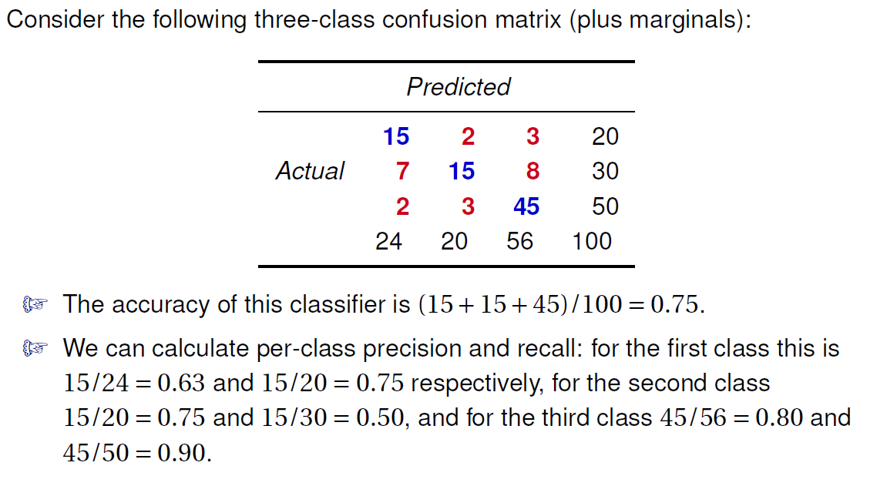
Example for K x K Contingency Table

Slide 5
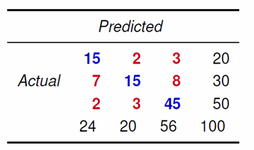
Example for K x K Contingency Table
We could average these numbers to obtain single precision and recall numbers for the whole classifier.
For instance, the average precision is (0.63+0.75+0.80)/3 = 0.72.
we could take a weighted average taking the proportion of each class into account.
For instance, the weighted average precision is 0.20*0.63+0.30*0.75+0.50*0.80 = 0.75.
Another possibility is to perform a more detailed analysis by looking at precision and recall numbers for each pair of classes:
when distinguishing the first class from the third precision is 15/17 = 0.88 and recall is 15/18 = 0.83,
while distinguishing the third class from the first these numbers are 45/48 = 0.94 and 45/47 = 0.96

Slide 6
Construction of multi-class classifiers
Imagine now that we want to construct a multi-class classifier, but we only have the ability to train two-class models
There are several ways to combine several of them into a single k-class classifier.
one-versus-rest scheme:
train k binary classifiers, the first of which separates class C1 from C2, . . . ,Cn, the second of which separates C2 from all other classes, and so on.
When training the i -th classifier we treat all instances of class Ci as positive examples, and the remaining instances as negative examples.
we learn k models, the i -th one separating Ci from Ci+1, . . . ,Cn with 1 ≤ i < n.
one-versus-one Scheme:
we train k(k −1)/2 binary classifiers, one for each pair of different classes.

Slide 7
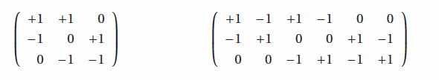
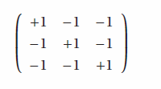
Construction of multi-class classifiers
A convenient way to describe all these schemes to decompose a k-class task into ‘l’ binary classification tasks is by means of a output code matrix.
This is a k-by-l matrix whose entries are +1, 0 or −1.
Ex:

Slide 8
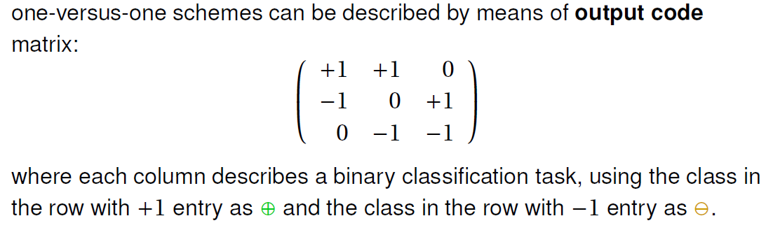
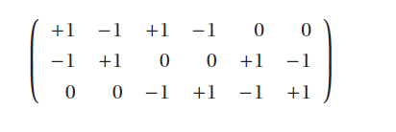
Construction of multi-class classifiers
The asymmetric scheme learns three more classifiers with the roles of positives and negatives swapped.

Slide 9
Prediction in Multi-Class Classifier
In order to decide the class for a new test instance for the scheme one-versus-rest:
Collect predictions from all binary classifiers which can again be +1 for positive, −1 for negative
Together, these predictions form a ‘word’ that can be looked up in the code matrix, a process also known as decoding.
Suppose the word is −1 +1 −1 then the decision should be class common in -1 prediction.

Slide 10

Prediction in Multi-Class Classifier
If the scheme is symmetric one-versus-one:
Check the nearest code word.
we define the distance between a word w and a code word c as
where i ranges over the columns in the code matrix.
That is, bits where the two words agree do not contribute to the distance;
bits where one word has +1 and the other −1 contributes 1;
and if one of the bits is 0 the contribution is 1/2,
The predicted class for word w is then argmin_{j} d(w,c _{j}), where c _{j} is the j -th row of the code matrix.

Slide 11
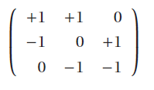
Prediction in Multi-Class Classifier
suppose the word is (0, +1, 0), and the scheme is symmetric one-versus-one:
So, if w = (0, +1, 0) then
d(w,c1) = 1 and
d(w,c2) = 1.5
d(w,c3) = 1.5,
which means that we predict C1.

Slide 12
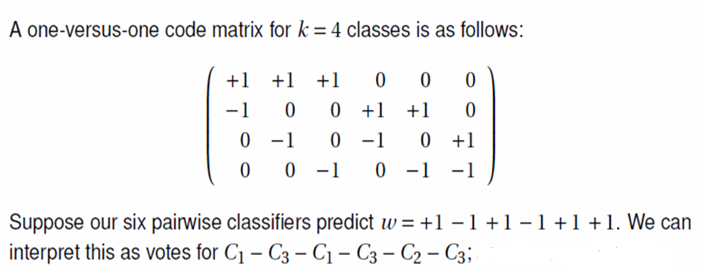
Prediction in Multi-Class Classifier

Slide 13
multi-class scores and probabilities
If we want to calculate multi-class scores and probabilities from binary classifiers, we have a number of different options.
We can use the distances obtained by loss-based decoding and turn them into scores by means of some appropriate transformation.
we can use the output of each binary classifier as features (real valued if we use the scores, binary if we only use the predicted class) and train a model that can produce multi-class scores, such as naive Bayes or tree models. This requires additional training.
A simple alternative that is also generally applicable and often produces satisfactory results is to derive scores from coverage counts: the number of examples of each class that are classified as positive by the binary classifer.

Slide 14
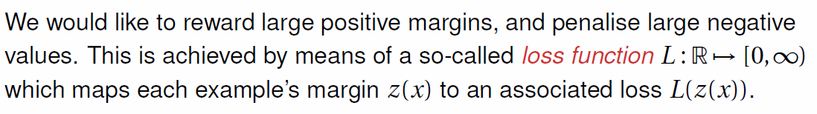
Margins and Loss Function of scoring classifier
If we take the true class c(x) as +1 for positive examples and -1 for negative examples, then the quantity z(x) =c(x) *s(x) is positive for correct predictions and negative for incorrect predictions.
The quantity z(x) is called the margin assigned by the scoring classifier.

Slide 15
Multi Class Classification with scoring Binary Classifier
If our binary classifiers output scores :
we assume that the sign of the scores ‘si’ indicates the class.
We can then use the appropriate entry in the code matrix ’c j i’ to calculate a margin zi = si *c j i , which we feed into a loss function L.
We thus define the distance between a vector of scores s and the j -th code word c j as
d(s,c j ) = ∑L(si *c j i ),
and we assign the class which minimizes this distance.
This way of arriving at a multi-class decision from binary scores is called loss-based decoding.

Slide 16
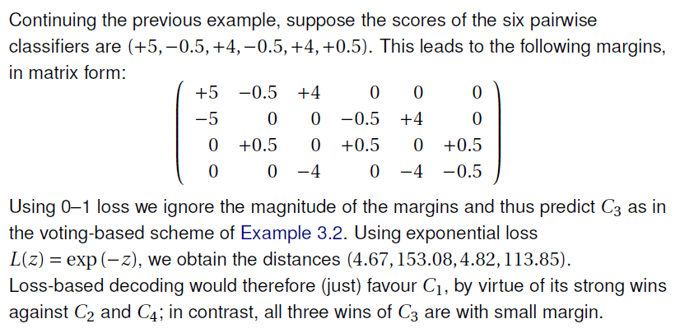
Ex for Multi Class Classification with scoring Binary Classifier

Slide 17
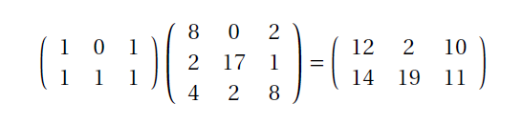
Coverage Counts
Suppose we have three classes and three binary classifiers which either predict positive or negative.
The first classifier classifies 8 examples of the first class as positive, no examples of the second class, and 2 examples of the third class.
For the second classifier these counts are 2, 17 and 1, and for the third they are 4, 2 and 8.
Suppose a test instance is predicted as positive by the first and third classifiers.

Slide 18

multi-class probabilities
In previous Example, we can divide the class counts by the total number of positive predictions. This results in the following class distributions: (0.80,0, 0.20) for the first classifier, (0.10,0.85,0.05) for the second classifier, and (0.29, 0.14, 0.57) for the third.
The probability distribution associated with the combination of the first and third classifiers is

Slide 19
Multi-class probabilities
Similarly, the distribution associated with all three classifiers is

Slide 20
Topics
Handling more than Two Classes
Regression
Unsupervised and Descriptive Learning

Slide 21
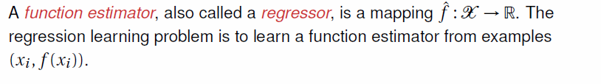
Regression
In all the tasks considered so far such as classification, scoring, and probability estimation--- the label space was a discrete set of classes.

Slide 22
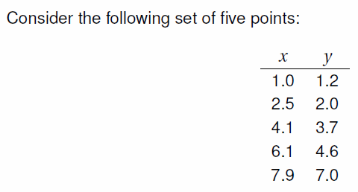
Example for Regression
We want to estimate y by means of a polynomial in x

Slide 23
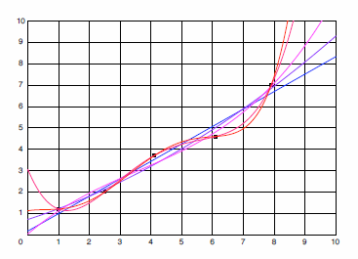
Example for Regression

Slide 24
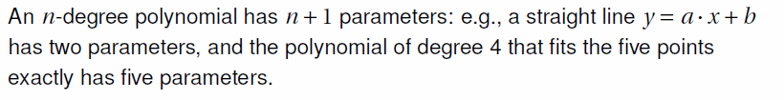
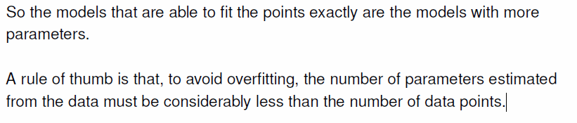
Overfitting in Regression

Slide 25
Evaluating the Regression Model
We have seen that classification models can be evaluated by applying a loss function to the margins, penalizing negative margins (misclassifications) and rewarding positive margins (correct classifications).
Regression models are evaluated by applying a loss function to the residuals f (x)− ˆ f (x).
The most common choice here is to take the squared residual as the loss function.

Slide 26
Errors in Machine Learning
In machine learning, an error is a measure of how accurately an algorithm can make predictions for the previously unknown dataset.
On the basis of these errors, the machine learning model is selected that can perform best on the particular dataset.
There are mainly two types of errors in machine learning, which are:
Reducible errors: These errors can be reduced to improve the model accuracy. Such errors can further be classified into bias and Variance.
Irreducible errors: These errors will always be present in the model

Slide 27
Bias–Variance dilemma
If we underestimate the number of parameters of the model, we will not be able to decrease the loss to zero, regardless of how much training data we have.
On the other hand, with a larger number of parameters the model will be more dependent on the training sample, and small variations in the training sample can result in a considerably different model.
This is called the bias–variance dilemma

Slide 28
Bias
Bias is the difference between the average prediction of our model and the correct value which we are trying to predict.
High Bias indicates more assumptions in the learning algorithm about the relationships between the variables.
Less Bias indicates fewer assumptions in the learning algorithm.
Examples of Low-bias machine learning algorithms: Decision Trees, k-Nearest Neighbors and Support Vector Machines.
Examples of High-bias machine learning algorithms:
Linear Regression, Linear Discriminant Analysis and Logistic
Regression.

Slide 29
Variance
The variance would specify the amount of variation in the prediction if different data was used.
Model with high variance pays a lot of attention to training data and does not generalize on the data which it hasn’t seen before.
As a result, such models perform very well on training data but has high error rates on test data.
Low Variance: Suggests small changes to the estimate of the target function with changes to the training dataset.
High Variance: Suggests large changes to the estimate of the target function with changes to the training dataset

Slide 30
Bias-Variance
when there is a high bias, it results in a very simplistic model that does not consider the variations very well. Since it does not learn the training data very well, it is called Underfitting.
When there is high variance (for small variation in the input data the model prediction changes a lot), the model learns too much from the training data, it is called overfitting.

Slide 31
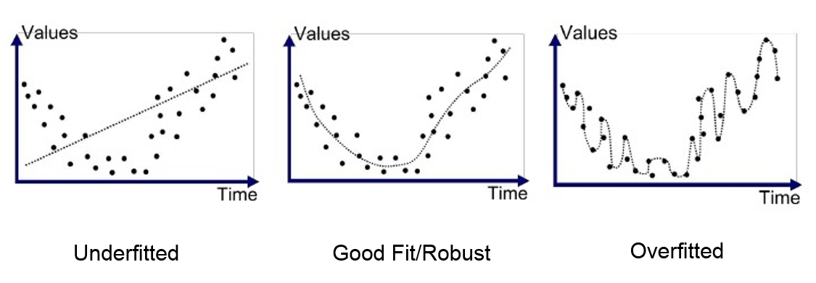
Bias and Variance

Slide 32
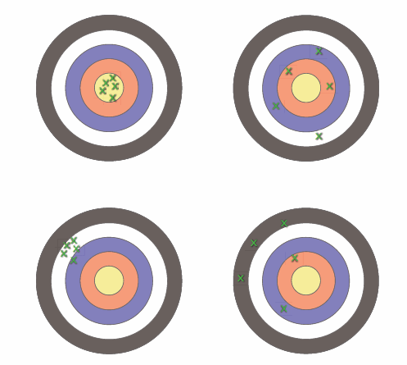
Bias- Variance with bulls eye diagram

Slide 33
Bias- Variance Diagram
Low-Bias, Low-Variance: The combination of low bias and low variance shows an ideal machine learning model. However, it is not possible practically.
Low-Bias, High-Variance: With low bias and high variance, model predictions are inconsistent and accurate on average. This case occurs when the model learns with a large number of parameters and hence leads to an overfitting
High-Bias, Low-Variance: With High bias and low variance, predictions are consistent but inaccurate on average. This case occurs when a model does not learn well with the training dataset or uses few numbers of the parameter. It leads to underfitting problems in the model.
High-Bias, High-Variance: With high bias and high variance, predictions are inconsistent and also inaccurate on average.

Slide 34
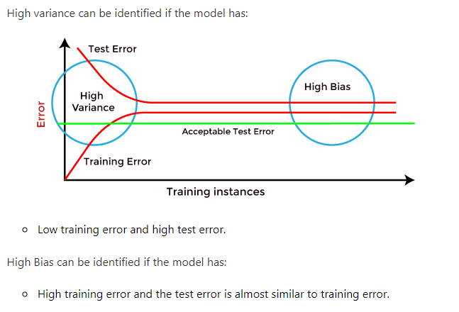
How to identify High variance or High Bias?

Slide 35
Ways to handle High variance or High Bias
Ways to reduce High Bias:
1. Increase the input features as the model is under-fitted.
2. Decrease the regularization term.
3. Use more complex models, such as including some
polynomial features.
Ways to Reduce High Variance:
1. Reduce the input features or number of parameters as a
model is over-fitted.
2. Do not use a much complex model.
3. Increase the training data.
4. Increase the Regularization term.

Slide 36
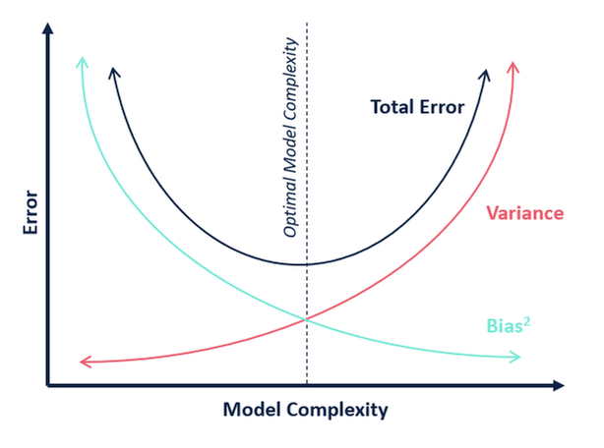
Bias- Variance Tradeoff

Slide 37
Topics
Handling more than Two Classes
Regression
Unsupervised and Descriptive Learning

Slide 38
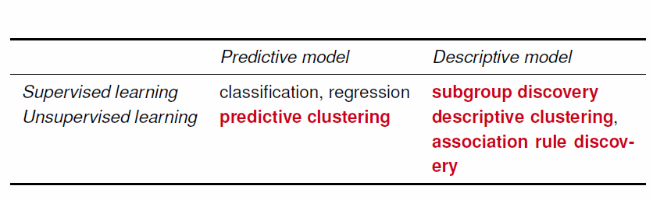
Unsupervised and Descriptive Learning

Slide 39
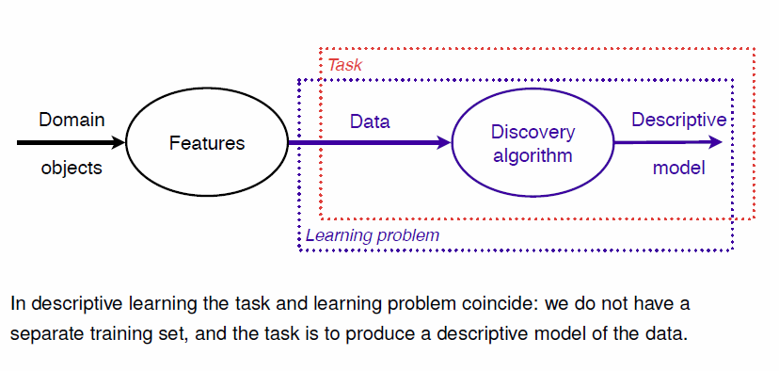
Descriptive Learning

Slide 40
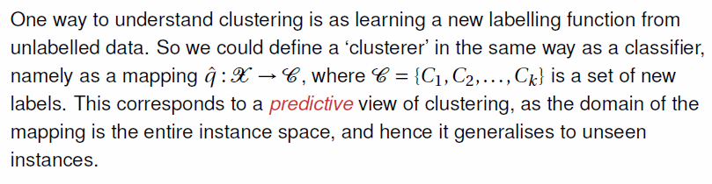
Predictive and Descriptive Clustering
A descriptive clustering model learned from given data D ⊆ X would be a mapping ˆ q :D →C whose domain is D rather than X.

Slide 41
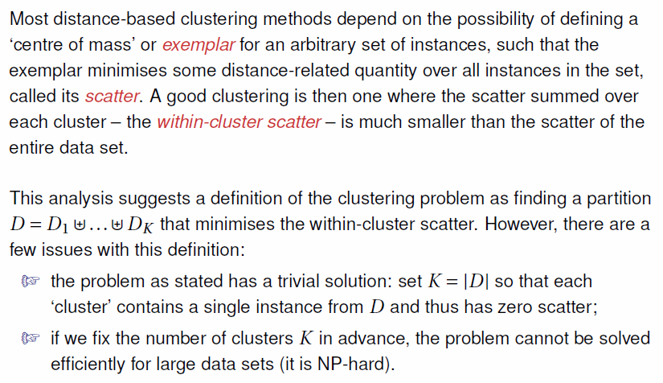
Distance based Clustering

Slide 42
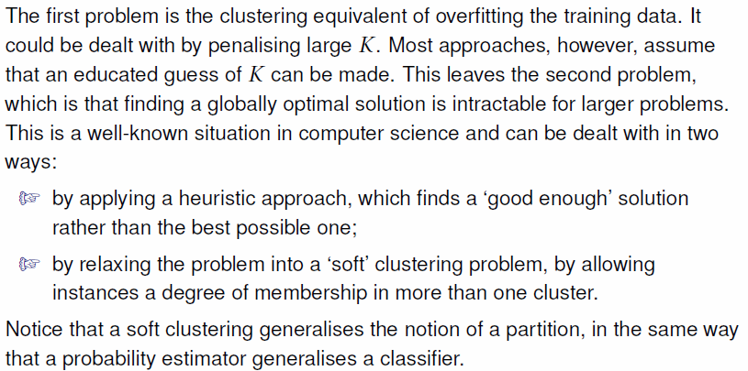
Distance based Clustering

Slide 43
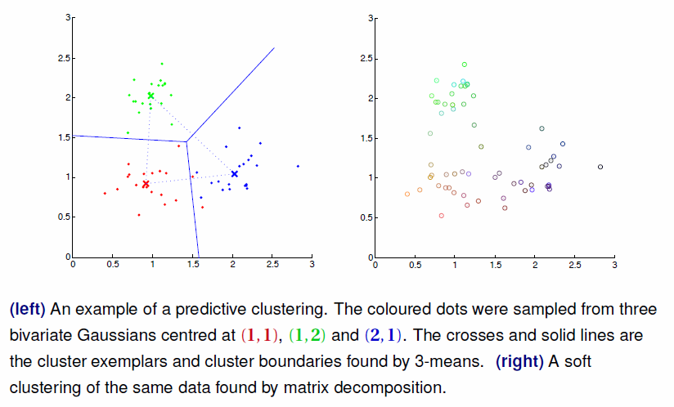
Distance based Clustering

Slide 44
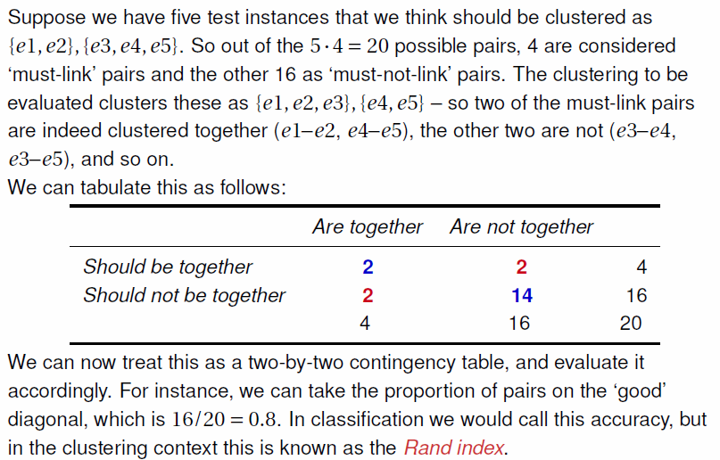
Evaluating the Clustering

Slide 45
Other Descriptive Models
Association Rule Mining
Subgroup Discovery

Slide 46
Topics
Handling more than Two Classes
Regression
Unsupervised and Descriptive Learning

